Slide 1
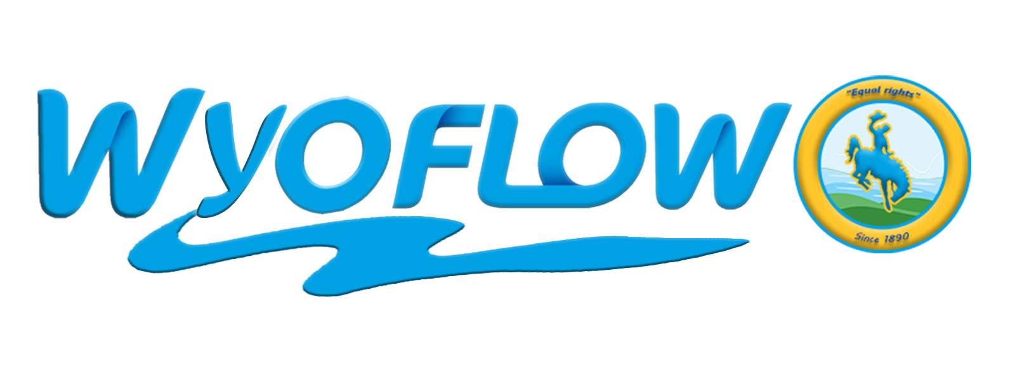
Utility Token Platform Conserving Wyoming Water Resources
Barney Debnam, Bryson Kruk, Keenan Olsen, Tom Plunkett, Nick Ward

Slide 2

Relevant Challenges
Wyoming Blockchain Coalition
MakerDAO DAI
Consensys
Global Blockchain Summit

Slide 3

Utility Token Platform for Conserving Water Resources in Wyoming
Creating an Utility Token Exchange Platform to enable transactions between those who are willing to pay to conserve and those who are willing to conserve in exchange for payments
Minimum Viable Product focuses on Water Conservation
Carbon Offsets would be a similar use case
Current exchange systems have numerous intermediaries and high transaction costs
Greater efficiency can be found with decentralized peer to peer exchanges with low transaction costs

Slide 4


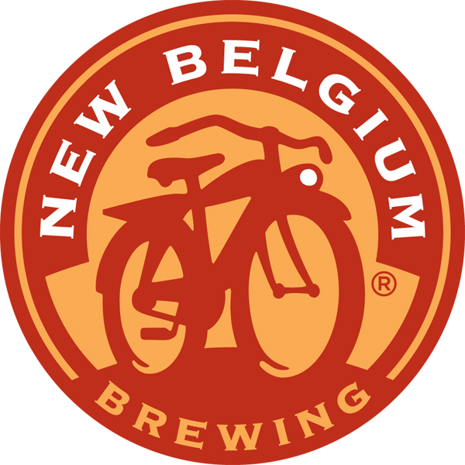
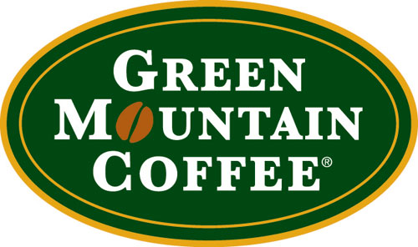
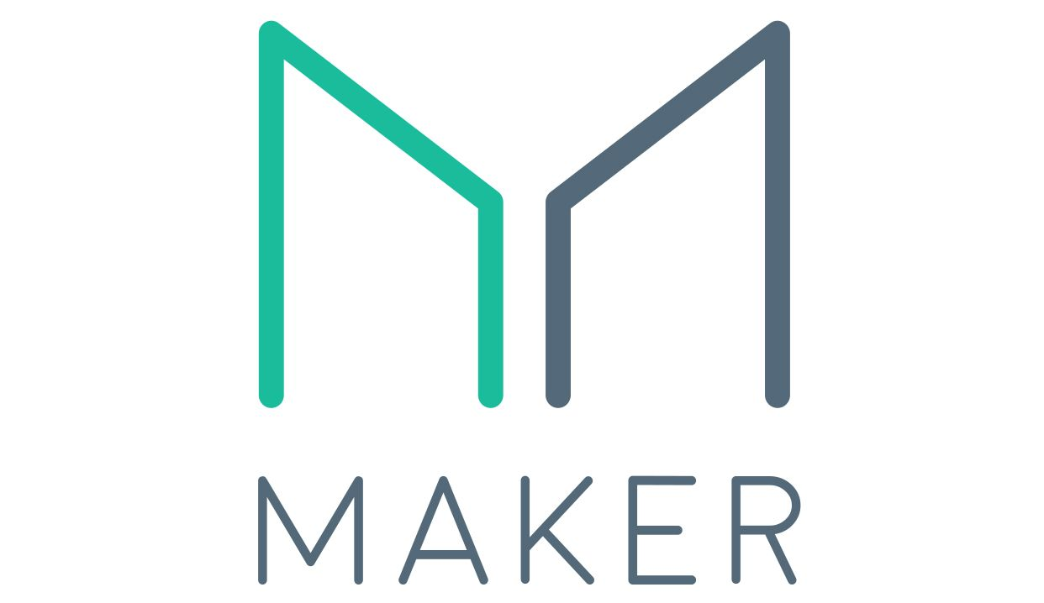
WyoFlow
ERC20
Smart Contract
Payor
Examples
WebApp
MetaMask
Wallet
ETH
ERC20 token
WyoFlow
ERC721
Smart Contract
ETH
ETH
ERC721 token
Validator
Recruiter
Verifies field/water not used
Conserver
Examples:
Farmer leaving field fallow and not using water
ETH
DAI
MetaMask
Wallet
MakerDAO
DAI

Slide 5
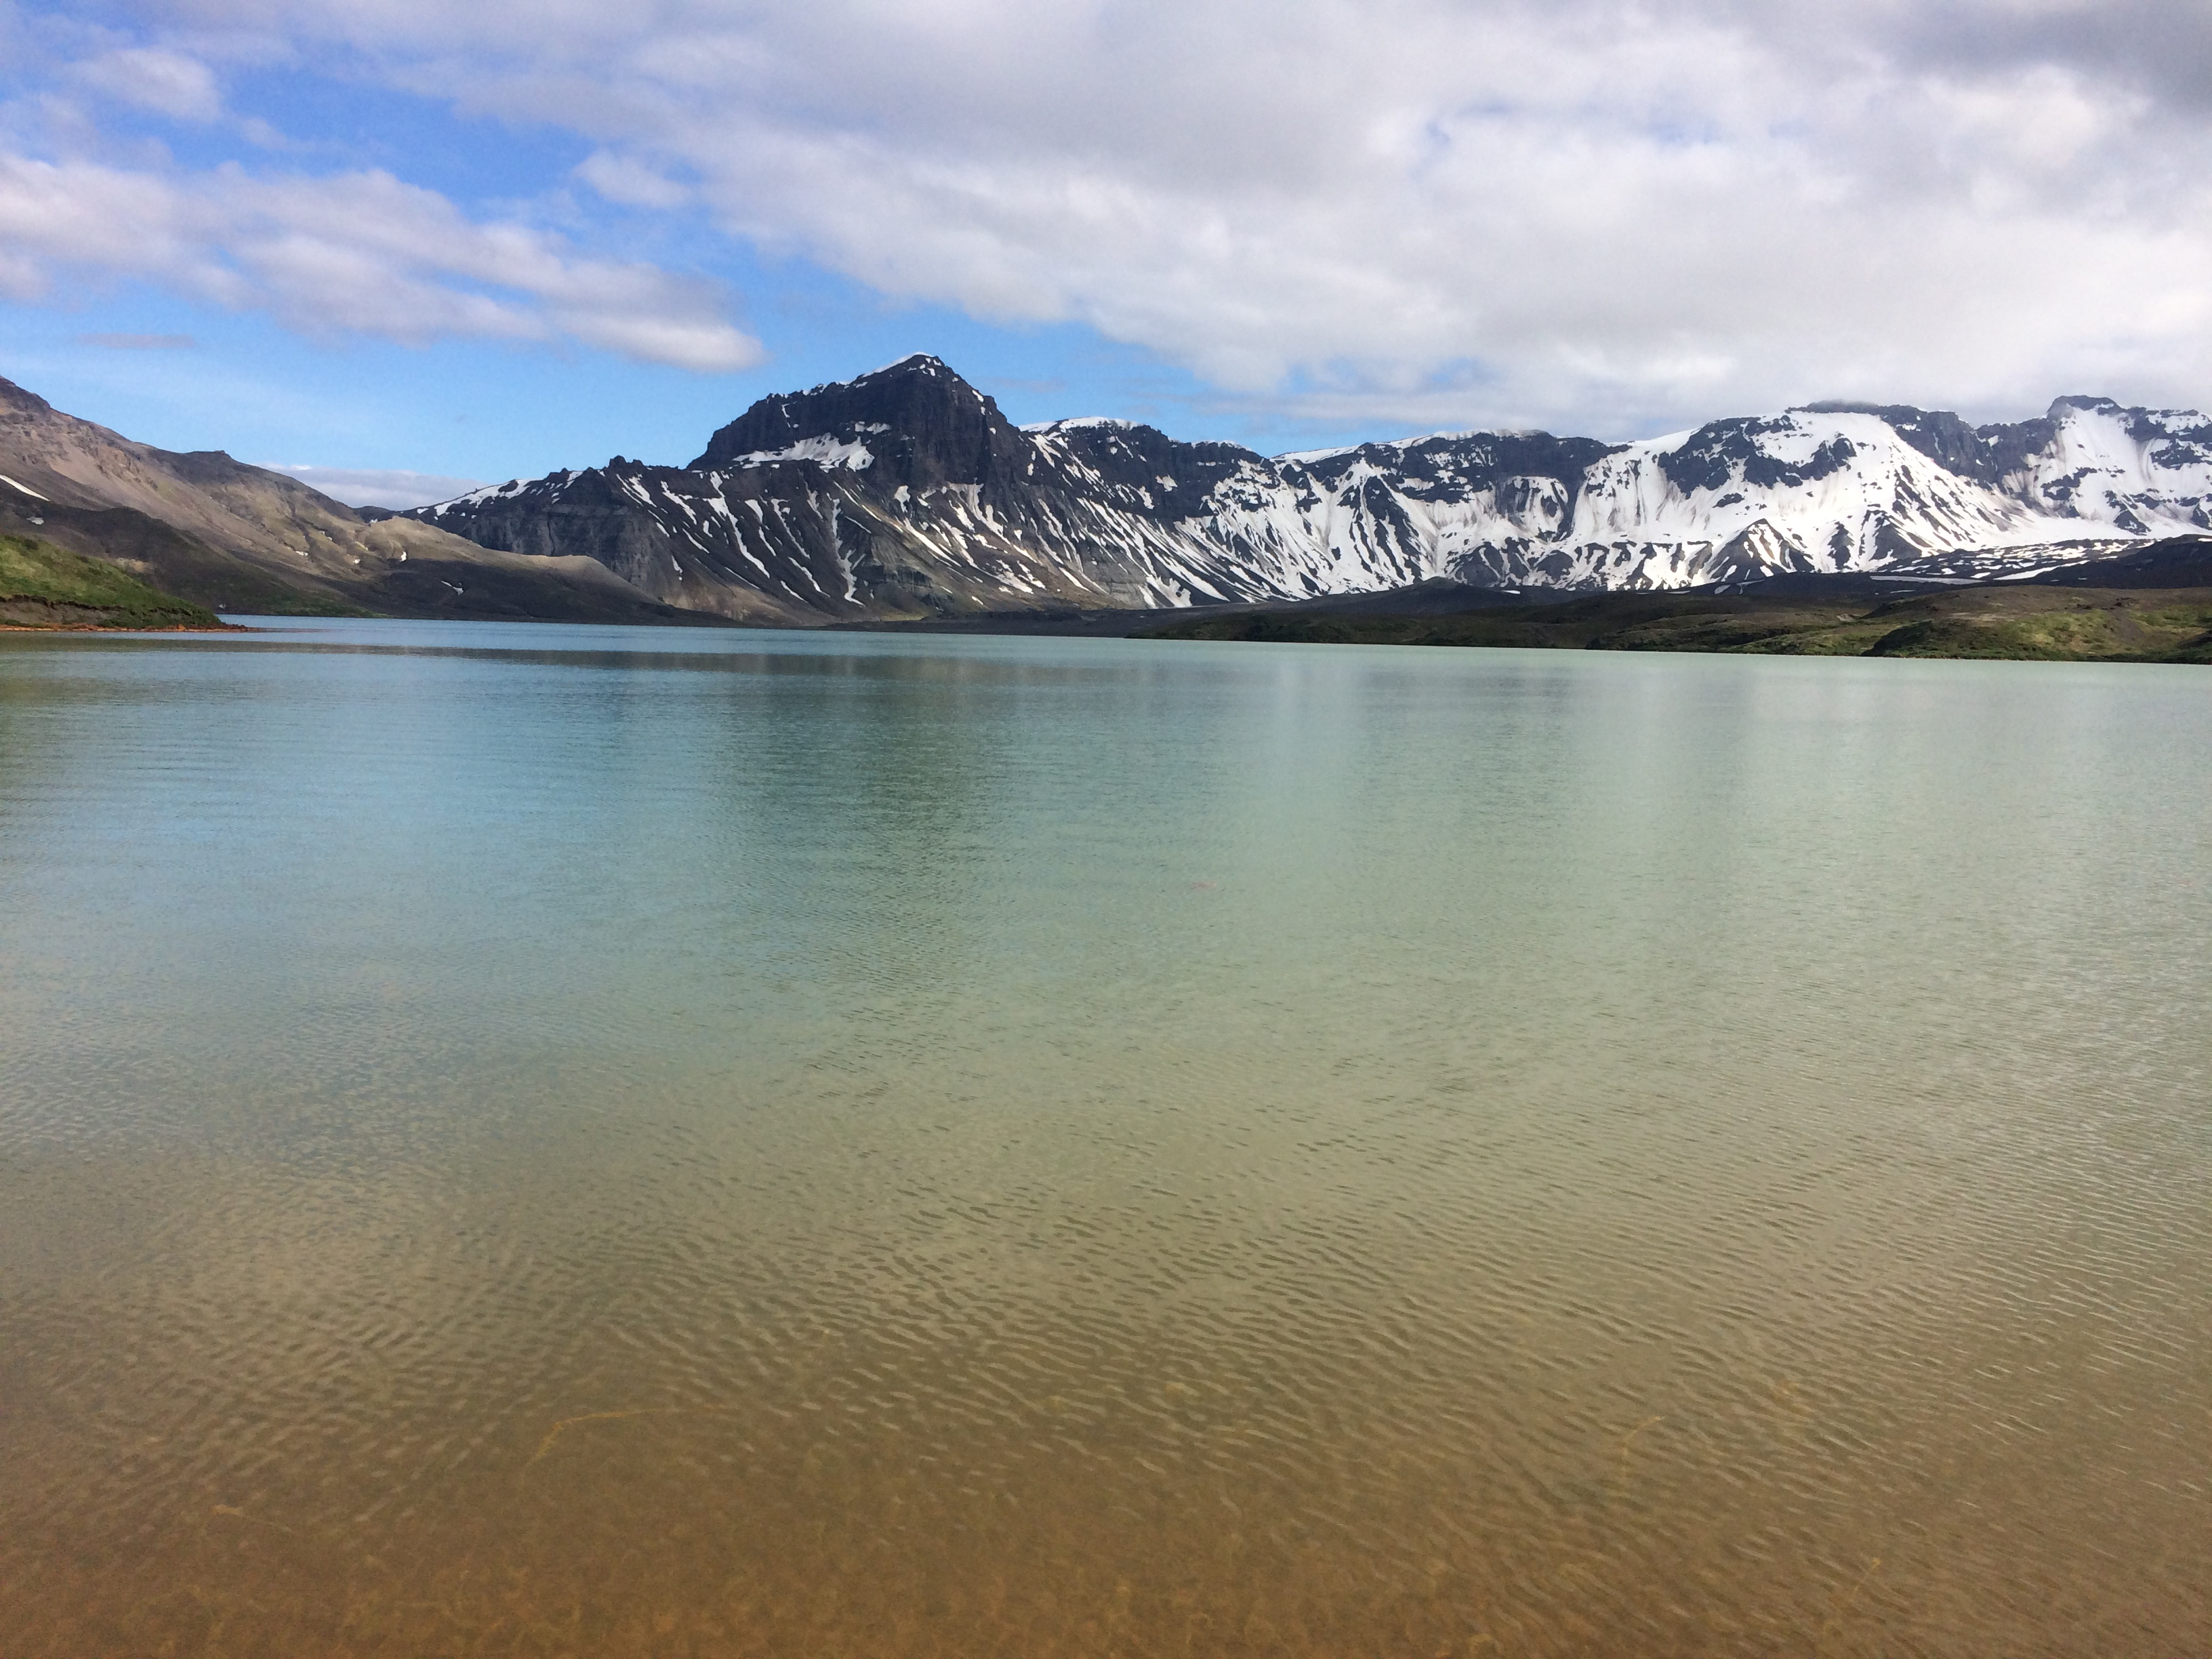
ERC721 Utility Token for Water Banking in Wyoming
2018 pilot Wyoming water conservation project pays farmers approximately $2.2 million for conserving 14,600 acre feet of water
Senator Hicks estimated that Water Banking could conserve 400,000 acre feet of water if the water was claimed by Wyoming and not left as system water
ERC721 Utility token could enable tracking of water to solve weaknesses of the current pilot and enable Wyoming Water Banking
Conserved Wyoming water “ought to have a bucking bronco on it,” Wyoming State Engineer Pat Tyrrell said.

